Slide 1
COVINET: A CONVOLUTIONAL NEURAL NETWORK APPROACH FOR PREDICTING COVID‑19 FROM CHEST X‑RAY IMAGES
Project guide: Ms. M. Jeyanthi, AP/IT
Team Members
Deena Dayalan M (1818111)
Hariprasath S (1818123)
Karthik S (1818131)
Thirupathi R (1818L11)

Slide 2
OBJECTIVE
To predict COVID-19 severity levels as Severe, Moderate, Mild, Normal-PCR+ or Negative on Chest X Ray images with high accuracy.

Slide 3
INTRODUCTION
COVID-19 is a pandemic that is spreading rapidly with every passing day and the cases have been reported from 222 countries and territories as of November 2021.
COVID - 19 is diagnosed by RT-PCR Testing, CT Scans and/or Chest X-Ray (CXR) Images.
CT scanners and RT-PCR testing are not available in most medical centres and hence in many cases CXR images become the most time/cost effective tool for assisting clinicians in making decisions.
Deep learning neural networks have a great potential for building COVID-19 triage systems and detecting COVID-19 patients.
We propose a customised CNN model that can accurately classify the patients infected with COVID-19 in five severity levels using chest X-rays.

Slide 4
LITERATURE SURVEY
Paper | Author | Classes | Model | Advantages | Drawbacks
COVID-Net: A tailored deep convolutional neural network design for detection of COVID-19 cases from chest radiography images,” 2020 | L. Wang | Normal, Pneumonia, COVID | COVIDNet | High accurate results are achieved by COVIDNet on COVIDx Dataset | The dataset is biased to severe COVID cases
COVID-CAPS: A Capsule Network-based Framework for Identification of COVID-19 cases from X-ray Images | P. Afshar | Normal, COVID | COVID-CAPS | It can handle small datasets, which is of significant importance due to sudden and rapid emergence of COVID-19 | It is not statistically reliable as they were evaluated on one single partition.

Slide 5
Paper | Author | Classes | Model | Advantages | Drawbacks
DeepCOVIDExplainer: Explainable COVID-19 Diagnosis Based on Chest X-ray Images | M. Karim | Normal, Pneumonia, COVID | VGC-19 + DenseNet-191 | It uses an ensemble of two CNN networks and highlight class discriminating regions in the input image using gradient-guided class activation maps (Grad-CAM++) and layer-wise relevance propagation (LRP). | The continual upsampling and downsampling processes may also result in loss of signal
Application of deep learning for fast detection of COVID-19 in X-Rays using nCOVNET | H. Panwar, P.K. Gupta | Negative, COVID-19 | Bayesian ResNet50V2 | The proposed model can detect COVID-19 positive patient in a short time. It also achieved a high accuracy with the limited dataset. | The dataset has only two classes – negative and positive which is limited as other datasets described had at least 3 classes.

Slide 6
EXISTING SYSTEM
COVIDNet
COVIDNet uses the COVIDx dataset which comprises of CXR images from five open access data repositories.
It was built to classify images as Normal, Pneumonia or COVID-19.
It reached a high accuracy, sensitivity and specificity
Drawbacks:
The data is highly heterogeneous.
This dataset does not provide severity levels, most positive cases are of severe patients.
The used dataset is biased to COVID cases.

Slide 7
PROPOSED SYSTEM
The drawbacks of the existing system are overcome by using a dataset which is categorized into severity levels.
Due to the potential and limitations of the most used COVID-19 CXR datasets and models, COVIDGR-1.0 dataset is built. It contains CXR images categorized into severity levels, normal, mild, moderate and severe.
To eliminate irrelevant information, we crop the lungs from the CXR images.
A customized CNN model is proposed that can accurately classify patients into five severity levels.
Our approach reaches good and stable results with high accuracy.

Slide 8
COVIDGR 1.0 DATASET
COVIDGR-1.0 is organized into two classes, positive and negative.
It contains 852 images distributed into 426 positive and 426 negative cases. Only Posterior Anterior (PA) view is considered.
More details are given below
Dataset | Class | #img | Women | Men | #img per severity level
COVIDGR-1.0 | Negative | 426 | 239 | 187
 | COVID-19 | 426 | 190 | 236 | Normal-PCR+: 76 Mild: 100 Moderate: 171 Severe: 79

Slide 9
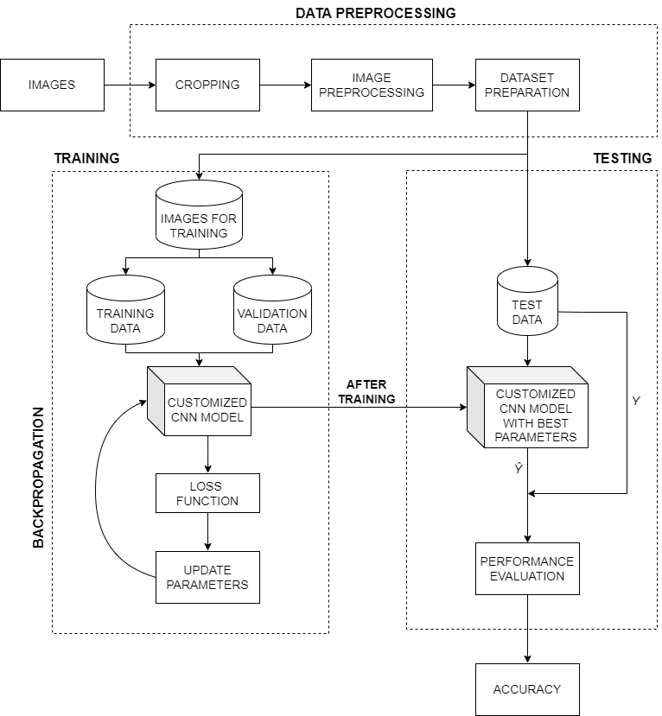
FLOW DIAGRAM

Slide 10
MODULES
The project is divided into three modules
DATA PREPROCESSING
CLASSIFICATION USING CNN MODEL
WEB DEPLOYMENT

Slide 11
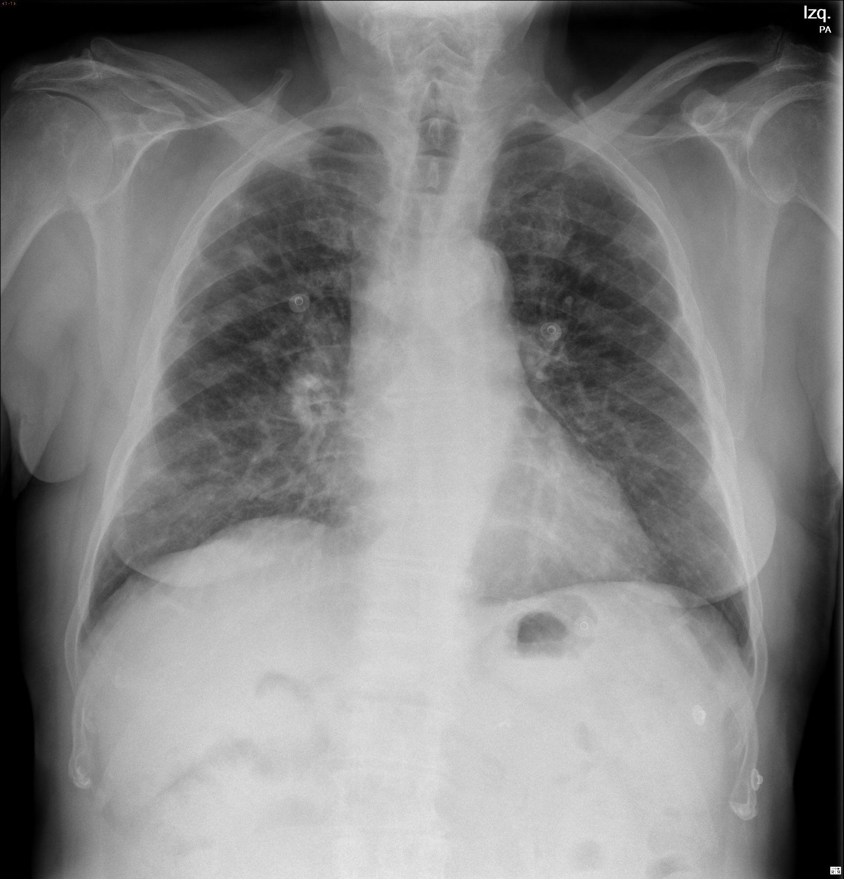
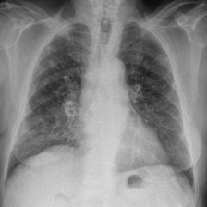
MODULE 1- DATAPREPROCESSING
1.1 CROPPING THE LUNGS
Different CXR equipment brands include different extra information about the patient in the sides and contour of CXRimages.
The position and size of the patient may also imply the inclusion of more parts of the body, e.g., arms, neck, stomach.
As this information may alter the learning of the classification model, first, we crop the lungs. The cropped images are in 224x224 pixels.
After cropping

Slide 12
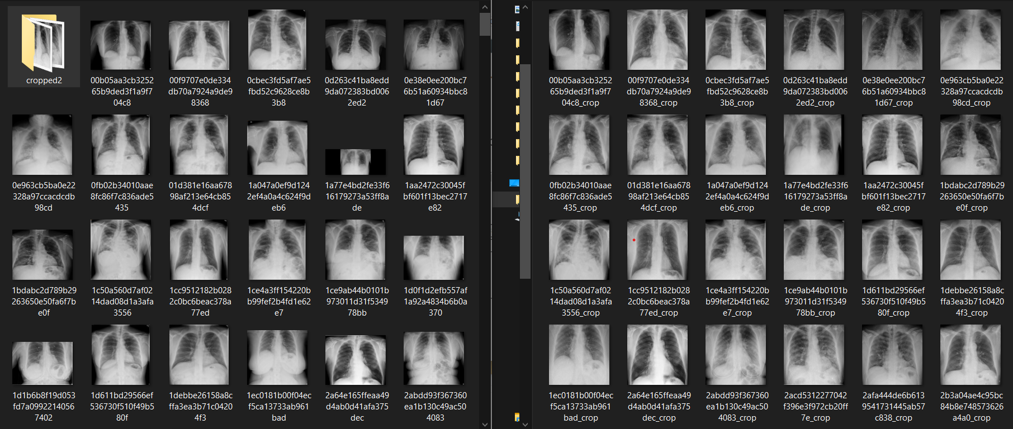
Original Images
Cropped Images

Slide 13
1.2 IMAGE PREPROCESSING
For edge detection, a value-based filter ([0,-1,0],[-1,6,-1],[0,-1,0]) is applied on the images which results in images with edges as shown in the figure.
As the third step, Blue Green Red (BGR) image is converted to the luma component, blue projection, and red projection (YUV). It reduces the resolution of the U and V channels but keeps Y at full resolution. And reducing U and V channels, the size of CNN can be reduced substantially.
As the last step, the YUV images are transformed back to BGR. It performs histogram normalization and smooths the edges.

Slide 14
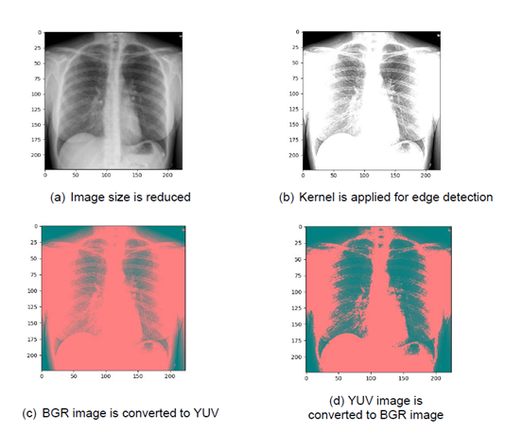

Slide 15
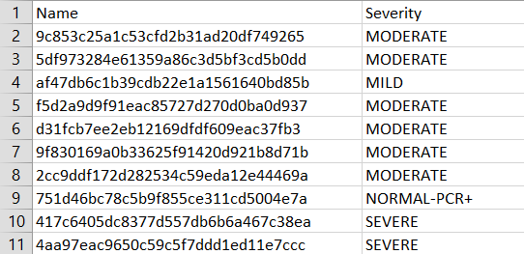
1.3 PREPARING THE DATA
In this module, we segregate cropped images into folders with their corresponding 4 severity levels.
Each image and its corresponding severity level is given in ‘severity.csv’

Slide 16
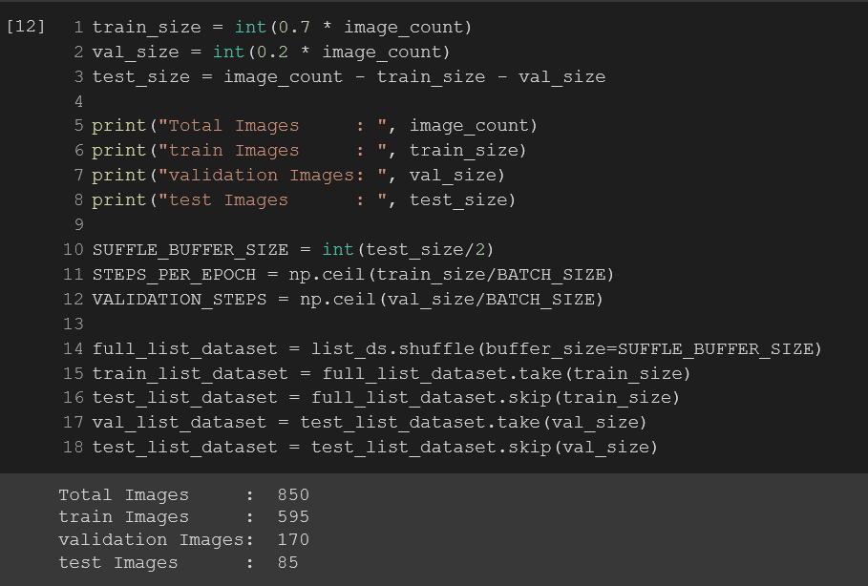
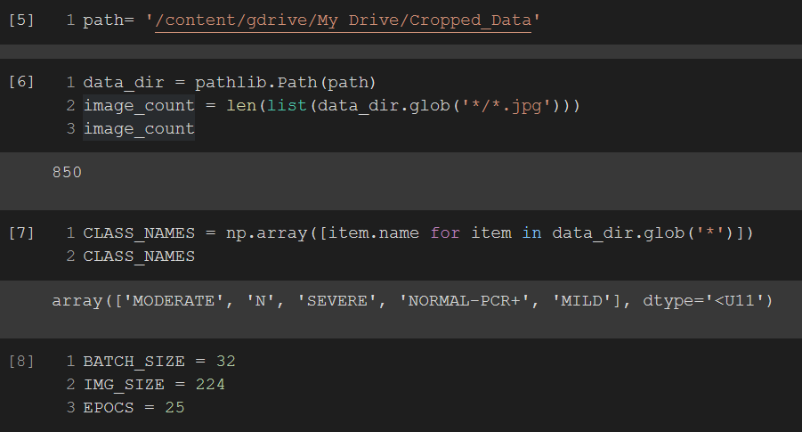
MODULE 2 - CLASSIFICATION USING CNN MODEL
The prepared data is imported into a colab notebook.
The dataset is divided into 70% train, 20% validation and 10% testing splits

Slide 17
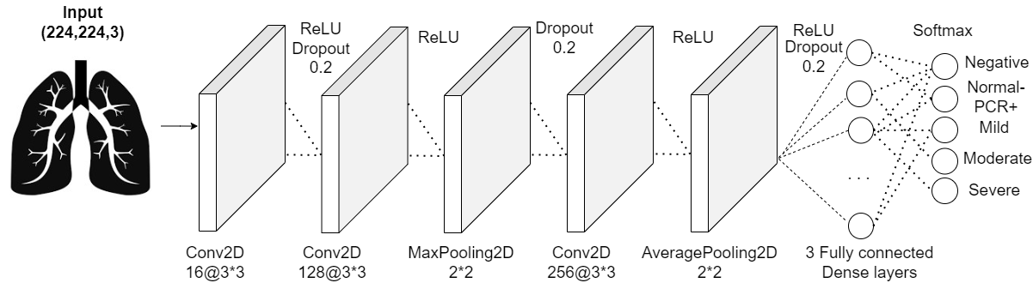
CNN ARCHITECTURE
For classification, a customized CNN model is used.
The architecture of the CNN model is given below.
Three convolution layers, Max pooling, Average Pooling and three Fully connected layers are used.
ReLU activation function is used in all layers except last layer
The last layer uses SoftMax activation function for prediction.
We are using ADAM optimizer and training the model for 50 epochs

Slide 18
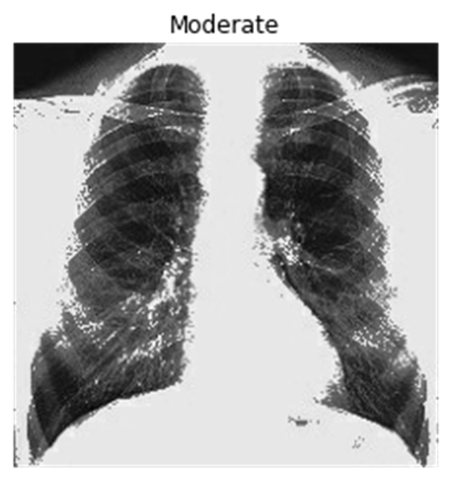
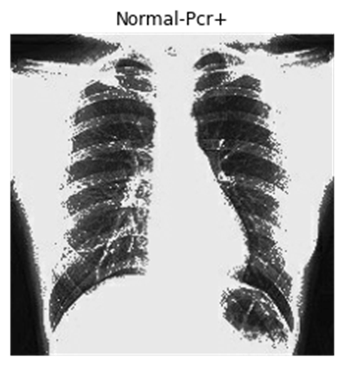
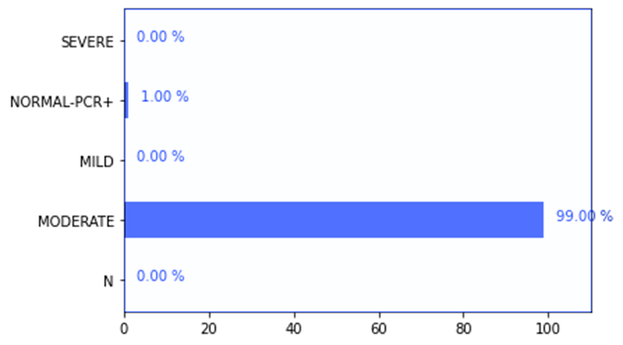
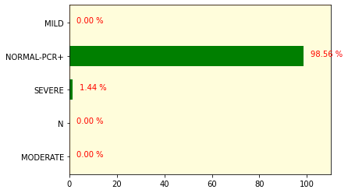
OUTPUT
Input Image
Prediction

Slide 19
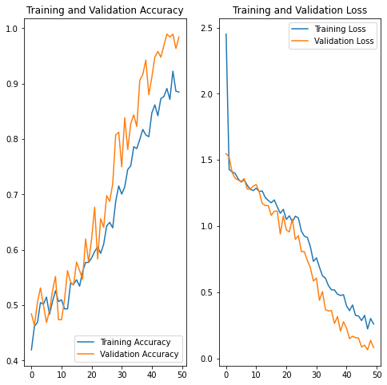
RESULTS
ACCURACY AND LOSS GRAPH

Slide 20
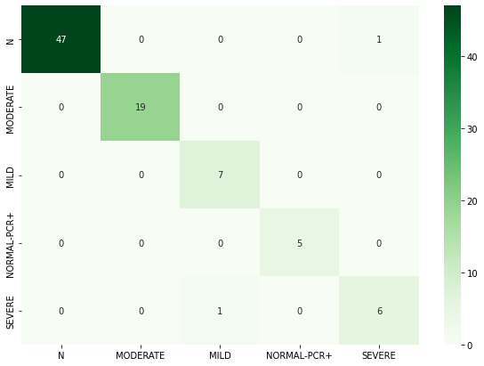
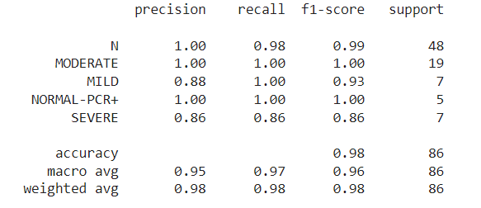
CONFUSION MATRIX
CLASSIFICATION REPORT
CONFUSION MATRIX

Slide 21
MODULE 3 - WEB DEPLOYMENT
The model is integrated into a web application for classification.
The user uploads a CXR image and it is fed into the model. The model makes a prediction and it is sent back to the webpage.
The backend is created using Flask which is a lightweight python framework for creating web applications. A simple web UI is created using HTML and CSS.

Slide 22
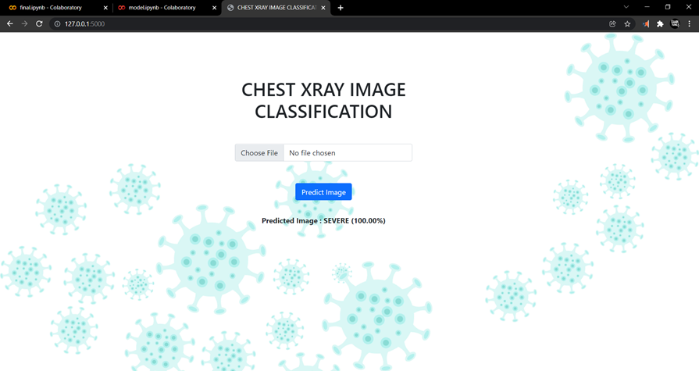
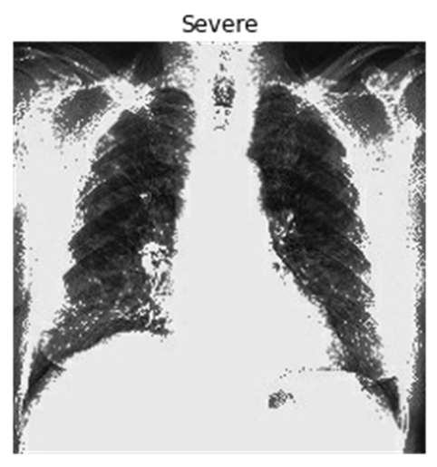
Input Image
Output

Slide 23
CONCLUSION
The proposed approach classifies patients as Negative, Normal-PCR+, Mild, Moderate and Severe using the COVIDGR-1.0 dataset.
This dataset includes four main COVID severity levels identified by a radiological study.
Data preprocessing is performed which helps in the segmentation of the lungs in the X-ray images.
A customized CNN model is used for accurately classifying the patients.
Results demonstrate that the proposed CNN model can predict COVID-19 patients with high accuracy. The Precision, Recall and F1 scores are also found to be high. Thus, the proposed approach is robust and produces high accuracy.

Slide 24
REFERENCES
[1] Wang L, Wong A, (2020) COVID-NET: A TAILORED DEEP CONVOLUTIONAL NEURAL NETWORK DESIGN FOR DETECTION OF COVID-19 CASES FROM CHEST X-RAY IMAGES, Sci Rep 10, 19549 (2020). https://doi.org/10.1038/s41598-020-76550
[2] P. Afshar et al., (2020) COVID-CAPS: A CAPSULE NETWORK-BASED FRAMEWORK FOR IDENTIFICATION OF COVID-19 CASES FROM X-RAY IMAGES, Pattern Recognition Letters, Volume 138, 2020, Pages 638-643, ISSN 0167-8655,
[3] M. Karim et al., (2020) DEEPCOVIDEXPLAINER: EXPLAINABLE COVID-19 PREDICTIONS BASED ON CHEST X-RAY IMAGES, arXiv:2004.04582 [eess.IV]
[4] H. Panwar, P.K. Gupta and M.K. Siddiqui et al. (2020) APPLICATION OF DEEP LEARNING FOR FAST DETECTION OF COVID-19 IN X-RAYS USING nCOVNET, Chaos, Solitons & Fractals, Volume 138, 2020, 109944, ISSN 0960-0779

Slide 25
THANK YOU

